Slide 1

How AI is changing how we think about data analysis

Slide 2
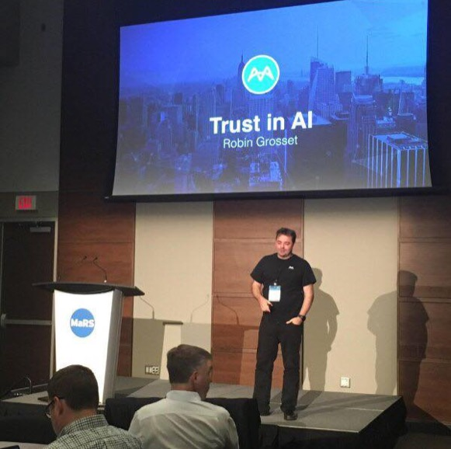
About me
Robin Grosset
Erstwhile Physicist from Scotland
20+ years in Business Analytics
16+ patents in the area of data processing, analytics and security
Founder, acquired twice: Cognos and IBM
Appointed IBM Distinguished Engineer
Watson Group in IBM, Chief Architect of Watson Analytics
“InfoWorld's 2016 Technology of the Year” winner
Now CTO of MindBridge working on revolutionizing financial anomaly detection with Artificial Intelligence

Slide 3
AI in the world of Big Data

Slide 4
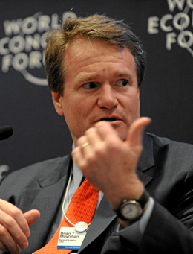
68% of CEOs believe data and analytics will generate the greatest return on stakeholder value
“The major trend that all industries face is the impact of technology on every single aspect of a company. Whether it’s enhanced intelligence, from big data analysis to help managing marketing, risk, product creation, or assessment of ideas … technology is going to lead to sea changes in how companies are organized and run across all industries”
Brian Moynihan Chief Executive Officer, Bank of America Corporation, US
Technology and the need for Analytics will drives change..
Source (PwC 19th Annual Global CEO Survey Published January 2016)
Photo © World Economic Forum, Photo by Michael Wuertenberg
* US - AU-C Section 240 / Canada - CAS 240 / UK - ISA 240

Slide 5

This is the end of ‘tech companies’ … only ‘companies’, steeped in technology will survive
Naval Ravikant commented, “Competing without software is like competing without electricity.” The rise of the Data era, coupled with software and connected device sprawl, creates an opportunity for some companies to outperform others. Those who figure out how to apply this advantage will drive unprecedented wealth creation and comprise the new S&P 500.
5 largest companies today are considered ‘tech companies’
(Apple, Alphabet, Microsoft, Facebook, Amazon)
NewCo. Rob Thomas: https://shift.newco.co/the-end-of-tech-companies-b093e82d1118#.a1x3955x2
Image attribution: Kris Krüg

Slide 6

Big Data Tsunami
Every day we create 2.5 quintillion bytes of data (10^18)
90% of the worlds data was created in the last 2 years
The current trend indicates data is doubling every 18 months
Leveraging this data is a big problem
data
People who can surf this wave are known as
data scientists…
time

Slide 7
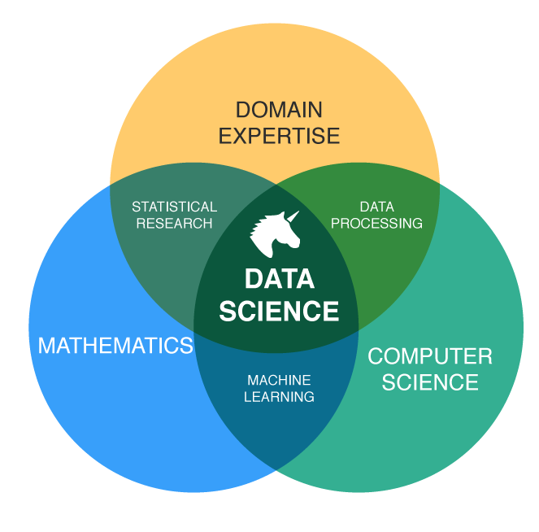
Data Science is in demand
3x as many job openings as people to fill them…
83% say they are struggling to find Data Scientists
human capital is in short supply...
https://www.datanami.com/2016/03/25/tracking-data-science-talent-gap/
Notes:
https://www.datanami.com/2016/03/25/tracking-data-science-talent-gap/

Slide 8




Big Data coping mechanisms
Sampling: look at a sample of events and determine if pattern looks acceptable or normal
Data Science: gathering, exploring, and modeling data
Machine Learning: techniques in computing science where a machine can learn from exposure to data in a supervised or unsupervised way
Artificial Intelligence: a field of computer science. Its goal is to enable the development of computers that are able to do things normally done by people -- in particular, things associated with people acting intelligently.

Slide 9
AI – Why now?

Slide 10

The new AI spring

Slide 11
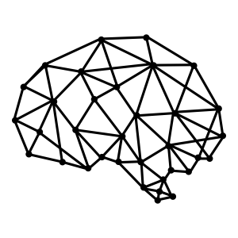
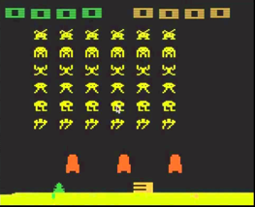
2014: DeepMind Q Learner
Reward (Score)
Raw Pixels
Game State
Game
Controls
Demis Hassabis
DeepMind Co-Founder

Slide 12
Artificial Intelligence is the new Electricity
“Just as electricity transformed almost everything 100 years ago, today I actually have a hard time thinking of an industry that I don’t think AI will transform in the next several years”
Andrew Ng,
Chief Scientist of Baidu; Chairman and Co-Founder of Coursera; Stanford CS faculty
https://www.gsb.stanford.edu/insights/andrew-ng-why-ai-new-electricity

Slide 13
How AI & Machine Learning are changing many professions
Insurance: Intelligent Claims Processing
Process mining to identify bottlenecks and improve efficiency. Identify patterns of fraud. Build predictive underwriting models
Legal: Paralegal Powered by AI
ROSS is an A.I. lawyer that helps human lawyers research faster and focus more on advising clients
Healthcare: Watson Oncology
Evidence based treatment options learned from world renowned MSK experts. “like having a capable, knowledgeable colleague” working with every clinician

Slide 14

A New Hope a new generation of AI
DeepMind acquired by Google for £400M
Google Cat Detector finds cats in videos completely unsupervised.
Uses Deep Reinforcement Learning
Why is this important?
More accurate than any previous method
Enabled by large scale Cloud compute
We can now train AIs quickly and in a general way to solve problems across different domains

Slide 15
Applying AI in the real world
The MindBridge Story

Slide 16

Our Mission: Uncover Irregularities in Data
What we see & know
~$200B annually
Financial loss due to human error or by intent is surging is ~$3T annually
Source: Association of Certified Fraud Examiners, International Institute of Auditors

Slide 17
Current Methods to Detect Anomalies are Failing
32
40%
Fraud caught by mistakes & tips
Months to Detect
3%
80%
Fraud caught by analytics
Surge in fraud incidents
the last 10 years
Source: Association of Certified Fraud Examiners, International Institute of Auditors

Slide 18





MindBridge Ai Auditor™ Uncovers Material Irregularities Using a Hybrid Approach
Domain Expertise & Business Rules
Integrity tests, fraud framework, standard fraud analytics
Statistical Methods
Benford’s law, regression, 3-digit testing
Machine Learning Humint Scoring, SOS, rarity, outlier detection, reinforced learning
Cross Correlation Sanction Lists, Credit Databases, proprietary negative database
Ai Auditor™

Slide 19
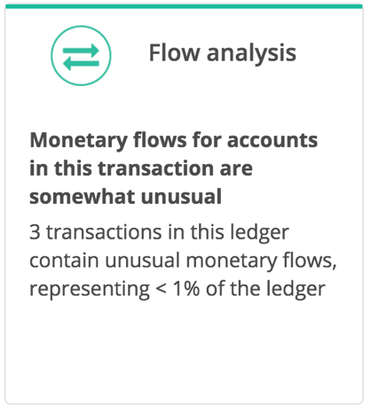
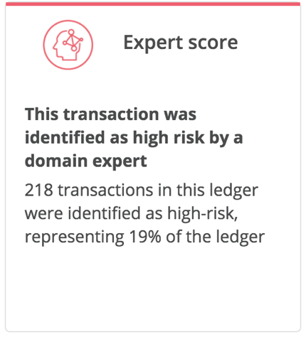
Uncovering Material Irregularities
Results…
“4 of 5 data points your system found were confirmed cases of fraud. Very impressive. Great job."
MindBridge Audit Client

Slide 20
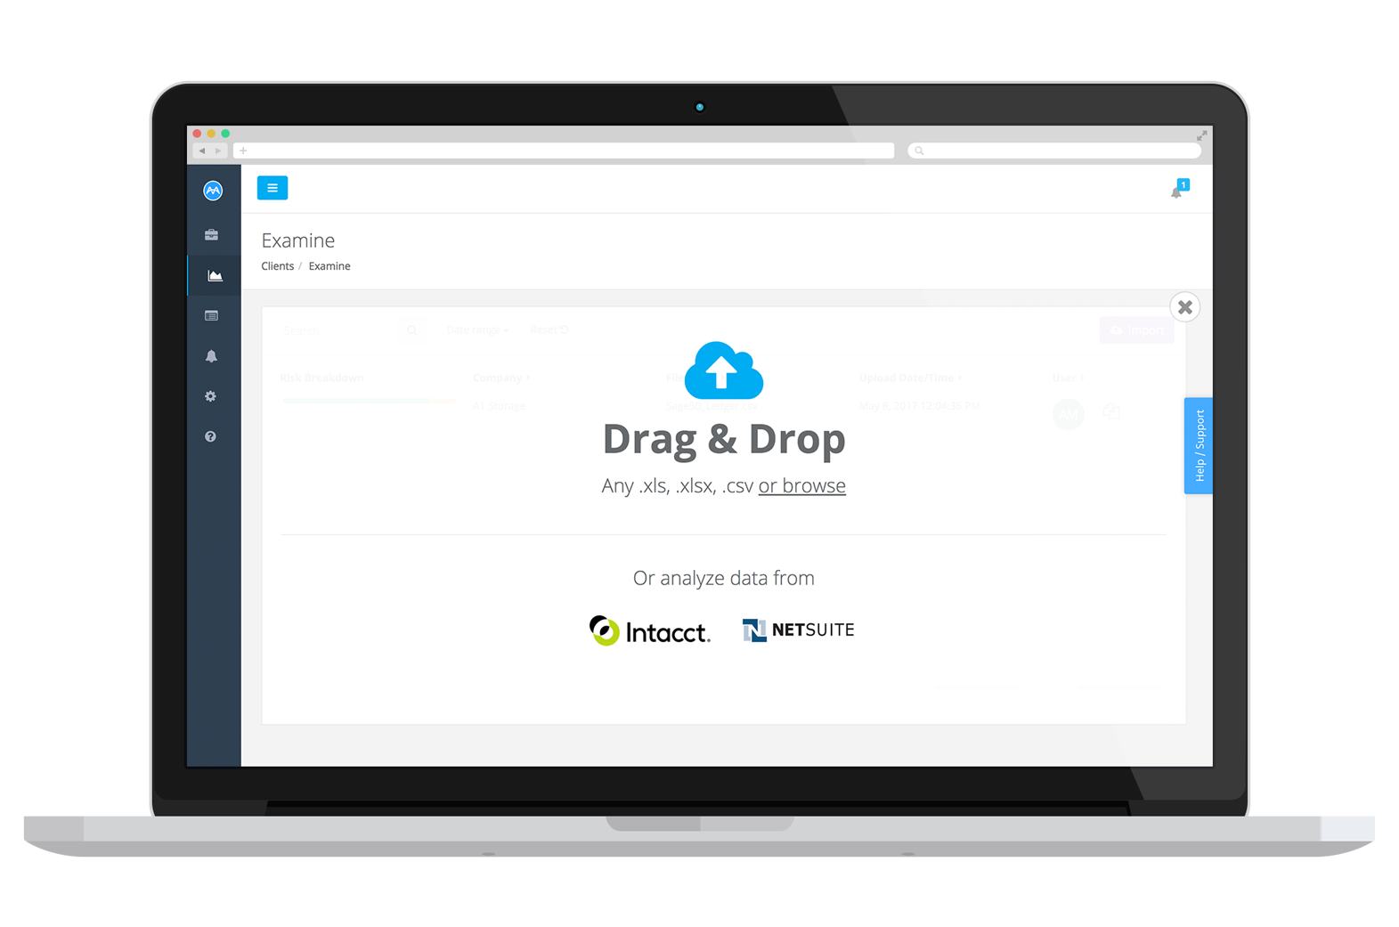
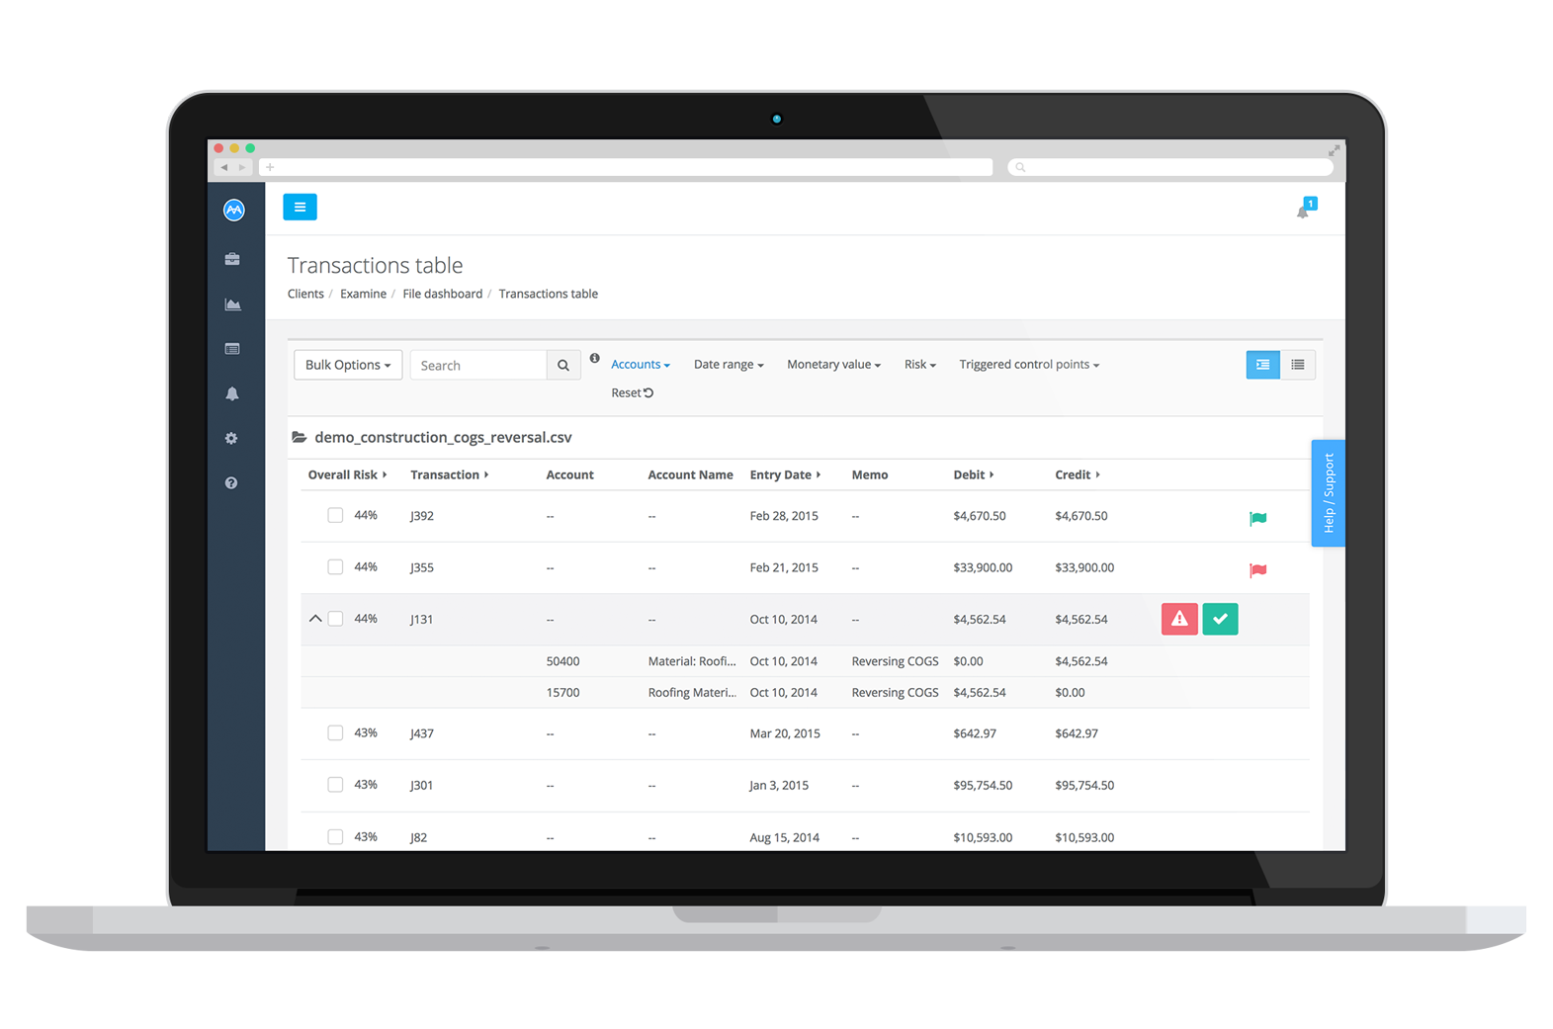
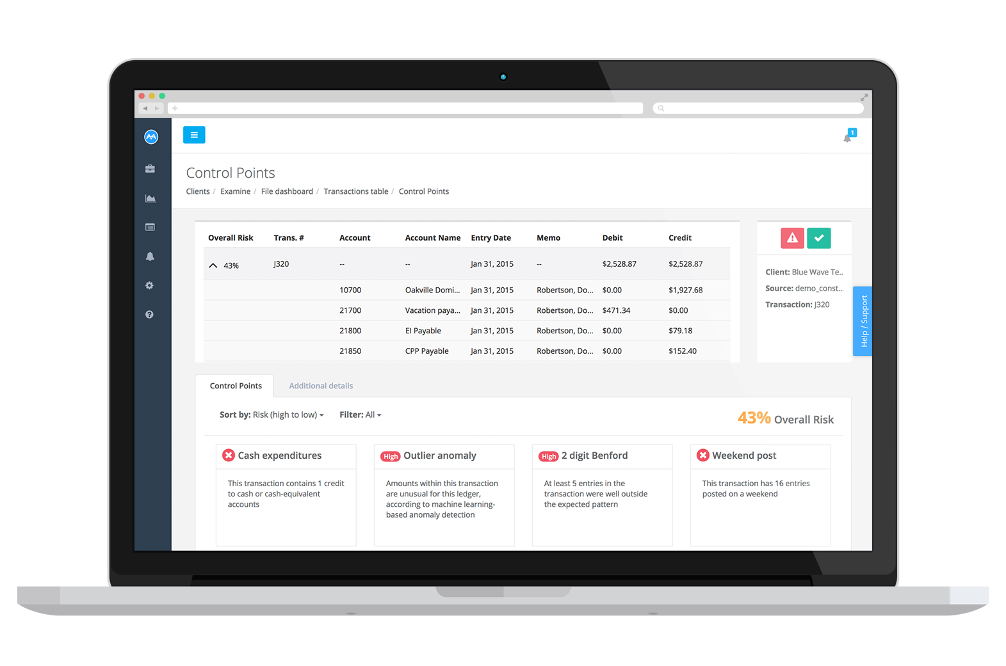
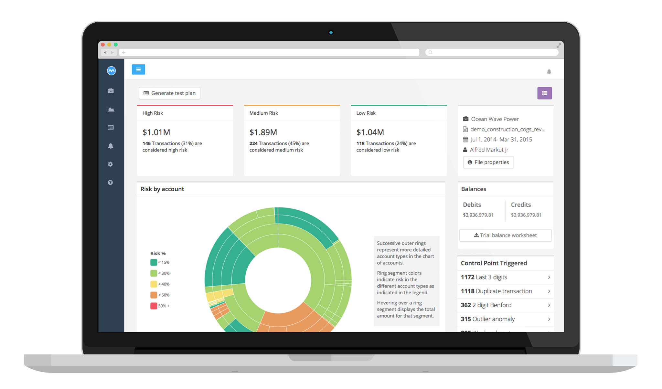
AI is making it easier
Smart Data Ingestion
Complete Data Analysis
Improved Detection Effectiveness
High Assurance
Notes:
Smart Data Ingestion
Load and create account grouping automatically
Reduce time in data preparation, input and low cognitive tasks
Make audit planning phase more efficient
Complete Data Analysis
Analyze and score every single transaction for unbiased review.
Economically and practically test 100% of the transactions.
Drive substantive findings can be shared as part developing trust with clients.
Improved Detection Effectiveness
Each transaction can be examined and is cross correlated by multiple machine learning algorithms, including rules, improving the chance of revealing relationships and patterns and boosting the audit quality.
High Assurance
Stratified risk-based sampling (with the option to include monetary value) as opposed to random sampling alone.
Based on the analysis already conducted, the platform stratifies the sample selection which greatly improves the quality of your sample.

Slide 21

Key Takeaways
Data is changing the world around us
Analytics is fueling a competitive future
Its no longer enough to to just analyse data we need to apply human like intelligence at vast scales…. and this means A.I.
A.I. is in all of our futures

Slide 22

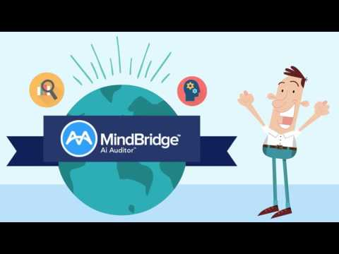
http://www.mindbridge.ai/bemike/
Notes:
Meet Mike

Slide 23


Thank You!
MindBridge AI
@mindbridge_ai
robin@mindbridge.ai

